Slide 1
Elementary Frontend Development
Jauntyliu @ SCGY-USTC

Slide 2
Content markups
<img>
<h1>...<h6> <p>
<ul><li>sth</li></ul> <ol><li>sth</li></ol>
<a>
<hr>
<table>
<blockquote>
<!-- -->

Slide 3
Browser Compatiabily Test
Different browsers renders slightly different;
It's vital to check your pages in different browsers.
Legacy browsers like IE6/7, should be treated with a banner noticing the out-of-date of such browsers.
Use User-Agent to detect in server side or use Javascript/Special Comments to detect in client side
Tools:

Slide 4
Character Sets and Character Encodings
liuzitan@liuzitan-s50:/media/liuzitan/SL-BG1/Code/HTML/charset$ hexdump TestASCII.txt
0000000 2041 7571 6369 206b 7262 776f 206e 6f66
0000010 2078 756a 706d 2073 766f 7265 6120 6c20
0000020 7a61 2079 6f64 2e67 000a
A₍₁₆₎:41
a₍₁₆₎:61

Slide 5
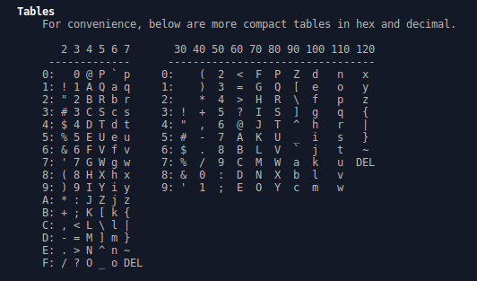

Slide 6
What happened?
2041 = (Space)A
7571 = uq
6369 = ci
206b = (Space)k
hexdump 这里是两字节一输出；x86 机器是小端字节序，高地址存高位；（但是其实单字节为一个单元的ASCII不存在字节序问题 ）u在q后面，是高位，所以是反着的
很绕，可以不理它

Slide 7
Character
liuzitan@liuzitan-s50:/media/liuzitan/SL-BG1/Code/HTML/charset$ hexdump TestASCII.txt -v -e '/1 "%02X "'
41 20 71 75 69 63 6B 20 62 72 6F 77 6E 20 66 6F 78 20 6A 75 6D 70 73 20 6F 76 65 72 20 61 20 6C 61 7A 79 20 64 6F 67 2E 0A
A quick brown fox jumps over a lazy dog.

Slide 8
About <meta> and character encoding
Web服务器可能（可以试一下，我没试）会检查在<head></head>里的 meta 标签，并且把 http-equiv 里面的内容当作一个Header Name，把content当作一个Header Content.
<meta>更重要的是给浏览器解析的时候用，可以在HTML文档里模拟一些HTTP Header的行为
但是<meta>设置的字符集设置没有HTTP头发送的字符集高
UTF-8 BOM 的优先级在最近除了IE10/11的浏览器之外最高，比HTTP头和<meta>都高（@w3.org）
<meta charset="iso-8859-1" /> (Unspecified in HTML4.01 but implemented by browsers)
<meta http-equiv="Content-Type" content="text/html; charset=iso-8859-1" />
（w3.org 推荐使用 UTF-8 encoding ）

Slide 9
About <meta>
<meta http-equiv="Content-Type" content="text/html; charset=utf-8" />...(index.html, charset UTF-8 Without BOM)
$ iconv -f utf-8 -t GB2312 -o index.gb2312.html index.html
iconv: 未知 2177 处的非法输入序列
<meta http-equiv="Content-Type" content="text/html; charset=utf-8" />...(index.gb2312.html, charset gb2312)

Slide 10
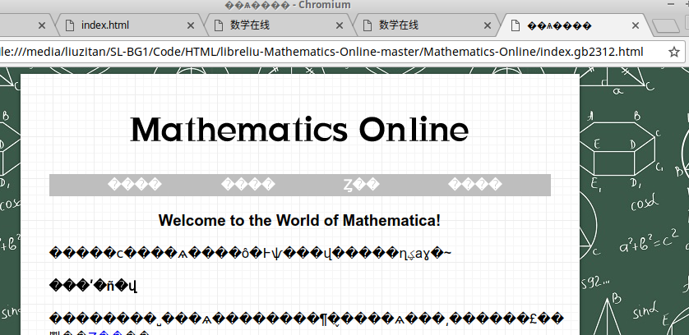
About <meta> - Bad <meta> tag

Slide 11
About <meta>
<meta http-equiv="Content-Type" content="text/html; charset=gb2312" />...(index.gb2312.correct.html, charset gb2312)
It works again~
Detailed Question: What if you use an ASCII-incompatible charset?
See www.w3.org/International/questions/qa-html-encoding-declarations

Slide 12
Furthermore
说的太多了也没啥用
有兴趣可以看看GB2312
和Unicode这个一统江湖的字符集
以及UTF-8字符编码

